Slide 1

Chapter 1
Thinking Like a Sociologist
© 2019 Cengage. All rights reserved.

Slide 2

Sociology
Scientific study of human behavior
  Implies that social behavior is regular and patterned
  Takes place between individuals, small groups, large organizations, and societies
Notes:
Discussion: Why might some people object to the scientific study of interaction?
Discussion: What would happen if we did not have patterned interactions?

Slide 3
Sociology: Application
True or False?
EVERYBODY KNOWS THAT…
The death penalty reduces crime.
Women’s earnings are now similar to men’s, especially in high-income occupations.
People age 65 and older make up the largest group of those who are poor.
There are more married than unmarried U.S adults.
Divorce rates are higher today than in the past.
Notes:
These and many other common sense ideas are false.
A sys study of interaction can show us what really happens.

Slide 4
Differentiating Common Sense and Sociology
Conventional Wisdom | Sociology
• Subjective | • Examines claims and beliefs critically
• Ignores facts | • Considers many points of view
• Varies across groups and cultures | • Enables us to move beyond established ways of thinking
• Based on myths and misconceptions | • Analyzes how social context influences people’s lives
• Also called common sense
Notes:
Common sense is subjective – If a woman crashes into one’s car, one might conclude, according to the conventional wisdom, statements that people have heard over the years, that “all women are terrible drivers.” Most drivers involved in crashes are men—especially teenagers and those age 70 and older.
Common sense ignores facts – Americans are most concerned about street crime, such as robbery or violent assaults by strangers. However, FBI and sociological data show that they are much more likely to be assaulted or murdered by someone they know or live with.
Common sense varies across groups and cultures – Many Americans believe that working harder decreases poverty. In contrast, Europeans tend to think that poverty is due to forces outside people’s control.
Much of one’s common sense is based on myths and misconceptions – A common myth is that living together is a good way to find out whether partners will get along after marriage. Generally, couples who live together before marriage have higher divorce rate than those who do not.
Discussion: Sociology is just common sense. Agree or disagree?

Slide 5
Seeing the Broader Social Context
How People Are Influenced by Their Society
  People Who Share a Culture
  People Who Share a Territory
Social Location
  Jobs − Income
  Education − Gender
  Age − Race/Ethnicity
Notes:
Groups make up our society when we share a culture and a territory.
Our social location depends on where we stand in our group membership.

Slide 6
Sociological Imagination
Ability to see the relationship between individual experiences and larger social influences
Microsociology: Examines the patterns of individuals’ social interaction in specific settings
Macrosociology: Examines large-scale patterns and processes that characterize society as a whole
Notes:
Sociological imagination emphasizes connection between personal troubles and structural issues. It relies on micro- and macro-level approaches to understanding social world.
Examples:
Personal troubles – An individual’s low educational attainment, lack of specific skills that employer wants, and failing to get a job.
Structural issues – Mass layoffs, outsourcing jobs, technological changes, and restrictive hiring policies.
Microsociology: How People Affect Our Everyday Lives
In most relationships, people interact with others on a micro, or “small,” level (such as members of a work group discussing who will perform which tasks).
Macrosociology: How Social Structure Affects Our Everyday Lives
Macro, or “large,” approaches are especially useful in understanding some of the constraints (such as economic forces and public policies).

Slide 7

Importance of Studying Sociology
Helps make informed decisions
Aids in understanding diversity
Shapes social and public policies and practices
Develops critical thinking
Expands career opportunities
Notes:
Examples:
Making informed decisions: Is grief counselling essential after the death of a loved one?
Understanding diversity: A white middle-class male who attends a private college would have a different experience from that of a female Vietnamese immigrant.
Shaping social and public policies: Sociology increases professional contributions.
Thinking critically: Critical thinking involves knowledge and problem solving. It facilitates an understanding of how individual lives, choices, and troubles are shaped by race, gender, social class, and social institutions.
Expanding your career opportunities: Sociologists are employed in administrative support and management, social services and counseling, sales and marketing, and teaching.
Sociology majors learn specific skills such as to work better with people, to organize information, and to write reports that nonsociologists can understand and interpret research findings.

Slide 8

Origins of Sociological Theory
Theories are developed to understand human behavior
  Theory: Set of statements that explains why a phenomenon occurs

Slide 9
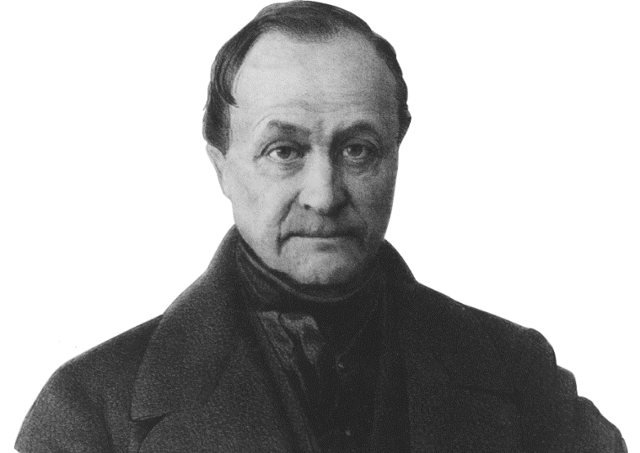
Early Sociological Theorists
Auguste Comte
  Father of sociology
  Advocated empirical study of society
  Wondered what holds society together
Applying the Scientific Method
to Social World
Coined the Term “Sociology”
Notes:
Auguste Comte coined the term sociology. He maintained that the study of society must be empirical; that is, information should be based on observations, experiments, or other data collection rather than on ideology, religion, intuition, or conventional wisdom. He saw sociology as the scientific study of two aspects of society: social statics and social dynamics.
Harriet Martineau (1802–1876), an English author, published several dozen books on a wide range of topics in social science, politics, literature, and history.
She emphasized the importance of systematic data collection through observation and interviews and an objective analysis of data to explain events and behavior.
She also published the first sociology research methods textbook. Martineau, a feminist and strong opponent of slavery, denounced many aspects of capitalism as alienating and degrading and criticized dangerous workplaces that often resulted in injury and death. Most scholars, including sociologists, ridiculed her ideas and dismissed them as too radical.
Sociology in the Media
“Chinese Women Push for a Place in Space” by Jaime A. FlorCruz
CNN, June 16, 2012
If chosen, the launch of China’s first woman taikonaut into space would come exactly 49 years to the day that the former Soviet Union put its first woman into space. Although Chinese women still face pressure to be traditional—get married, have a child, appear meek and submissive, etc.—breaking the stereotype is no longer taboo. Many have risen from obscurity, pursued educations, started businesses, had divorces and become self-made multi-millionaires.
What is your perspective on greater choice for women in society?
How does your generation address the increase in options for women?
How do college students perceive gender equality?
Discuss the most important issues related to feminism in modern society.

Slide 10
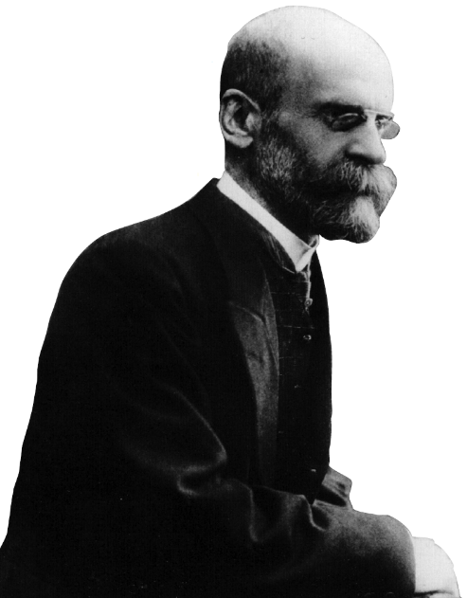
Early Sociological Theorists
Émile Durkheim
  Studied How Social Forces Affect Behavior
  Identified “Social Integration” – Degree to Which People Are Tied to Social Group
    People who have weaker social ties are more likely to commit suicide
Notes:
Émile Durkheim (1858–1917), a French sociologist and writer, agreed with Comte that societies are characterized by unity and cohesion because their members are bound together by common interests and attitudes. He maintained that social solidarity is maintained by a division of labor.
Social facts: Measurable aspects of social life external to the individual.
Social solidarity: Cohesion and harmony.
Division of labor: Interdependence of different tasks, occupations, and characteristics of industrialized societies that produces social unity and facilitates change.
Social Integration
Durkheim was one of the first sociologists to test a theory using data. In his classic study Suicide, Durkheim (1897/1951) relied on extensive data collection to test his theory that suicide is associated with social integration.
Durkheim’s concept of social integration is useful in explaining the high suicide rates of older white men. The rates may reflect depression, a sense of hopelessness because of terminal illnesses, and not being “connected” to family, friends, community groups, and support systems that women tend to develop throughout their lives.
Karl Marx attempted explaining societal changes during Industrial Revolution. He viewed industrial society to be composed of capitalists, petit bourgeoisie, and proletariat. His belief was that that society is divided into the haves and have-nots. He also contended that alienation is common across all social classes.
Capitalism: Economic system in which ownership of the means of production is in private hands.
Alienation: Feelings of separation from one’s group or society.
Sociology in the Media
“Spain Set to Reveal The Pain in Its Books”
CNN News, September 25, 2012
Spain, a Eurozone behemoth, is in the crosshairs of Europe’s financial crisis. The country is suffering from a number of problems that include soaring borrowing costs, a banking system with leaking cash and unemployment rates that have reached devastating levels. In a recent protest on June 12, 2012, the streets of Leon which is situated in northern Spain was lit up as several thousand coal miners marched turning their helmet lights on. The protest was part of a nationwide miners’ strike against subsidy reductions.
What examples of worker protest are occurring near your campus?
How do workers in your area see protests?
How is inequality part of the labor market?
What other ways do workers fight for wage concessions?

Slide 11


Durkheim believed that modern societies produce feelings of isolation, much of which come from the division of labor. In contrast, members of traditional societies, who work alongside family and neighbors and participate in similar activities, experience a high degree of social integration.

Slide 12
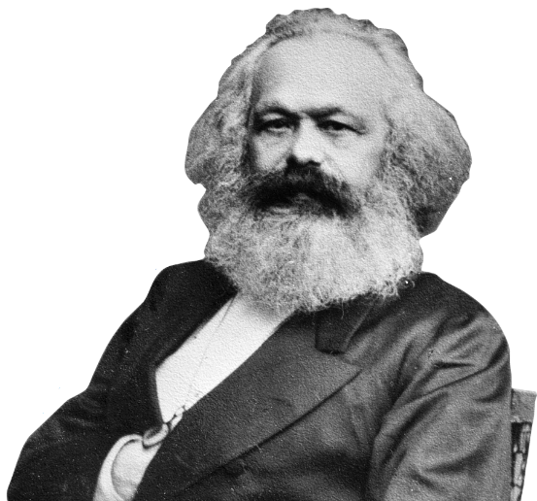
Early Sociological Theorists
Karl Marx
  Most influential social scientist
  Viewed development of capitalism as a social change
  Engine of Human History is Class Conflict
Introduced Conflict Theory
  The Bourgeoisie vs. The Proletariat
    Capitalists vs. the Exploited Workers
Notes:
Émile Durkheim (1858–1917), a French sociologist and writer, agreed with Comte that societies are characterized by unity and cohesion because their members are bound together by common interests and attitudes. He maintained that social solidarity is maintained by a division of labor.
Social facts: Measurable aspects of social life external to the individual.
Social solidarity: Cohesion and harmony.
Division of labor: Interdependence of different tasks, occupations, and characteristics of industrialized societies that produces social unity and facilitates change.
Social Integration
Durkheim was one of the first sociologists to test a theory using data. In his classic study Suicide, Durkheim (1897/1951) relied on extensive data collection to test his theory that suicide is associated with social integration.
Durkheim’s concept of social integration is useful in explaining the high suicide rates of older white men. The rates may reflect depression, a sense of hopelessness because of terminal illnesses, and not being “connected” to family, friends, community groups, and support systems that women tend to develop throughout their lives.
Karl Marx attempted explaining societal changes during Industrial Revolution. He viewed industrial society to be composed of capitalists, petit bourgeoisie, and proletariat. His belief was that that society is divided into the haves and have-nots. He also contended that alienation is common across all social classes.
Capitalism: Economic system in which ownership of the means of production is in private hands.
Alienation: Feelings of separation from one’s group or society.
Sociology in the Media
“Spain Set to Reveal The Pain in Its Books”
CNN News, September 25, 2012
Spain, a Eurozone behemoth, is in the crosshairs of Europe’s financial crisis. The country is suffering from a number of problems that include soaring borrowing costs, a banking system with leaking cash and unemployment rates that have reached devastating levels. In a recent protest on June 12, 2012, the streets of Leon which is situated in northern Spain was lit up as several thousand coal miners marched turning their helmet lights on. The protest was part of a nationwide miners’ strike against subsidy reductions.
What examples of worker protest are occurring near your campus?
How do workers in your area see protests?
How is inequality part of the labor market?
What other ways do workers fight for wage concessions?

Slide 13
Early Sociological Theorists
Max Weber
  Social organization
  Subjective understanding of behavior
Jane Addams
  Leader in the women’s suffrage movement
  Awarded Nobel Peace Prize
W.E.B Du Bois
  Examined oppressive effects of race and class
  Played a key role in reshaping black–white relations in America
Notes:
Max Weber (pronounced VAY-ber; 1864–1920) was a German sociologist, economist, legal scholar, historian, and politician. Weber focused on social organization, a subjective understanding of behavior, and a value-free sociology.
Social organization – Analyzed for a complete understanding of the society.
Subjective understanding – Requires knowing how people perceive the world. Weber described two types of subjective understanding—direct observational understanding and explanatory understanding.
Value free: Separating one’s personal values, opinions, ideology, and beliefs from scientific research.
Jane Addams cofounded Hull House—one of the first settlement houses in Chicago that served as a community center for the neighborhood poor. She published articles on the effects of social disorganization and immigration. She emphasized on applying knowledge to everyday problems.
Discussion: Is it possible to be a value-free sociologist? Should sociology be value-free?

Slide 14
Functionalism
Views society as a complex system of interrelated parts that work together to maintain stability
Each institution or social group has structures
Each structure fulfills a certain function
  Dysfunctions negatively impact society
  Includes manifest and latent functions
  Ignores social change and the inequality maintained by powerful people
Notes:
Otherwise known as structural functionalism.
Much of contemporary functionalism grew out of the work of Auguste Comte and Émile Durkheim.
Functions – purposes and activities that contribute to a society’s stability and survival.
Dysfunctions: Have a negative impact on a society. Religious intolerance leading to wars and terrorist attacks is an example of a dysfunction.
Manifest functions: Intended and recognized purposes and activities.
Latent functions: Unintended and unrecognized purposes and activities.
Functionalism couldn’t explain the many rapid changes sparked by the civil rights, women’s, and gay movements. In addition, conflict theorists pointed out that what is functional for some privileged groups is dysfunctional for many others.

Slide 15
Functionalism: Application
A school uniform
  What are the manifest functions?
  What are the latent functions?
  What are the dysfunctions?
A fast-food restaurant
  What are the manifest functions?
  What are the latent functions?
  What are the dysfunctions?
Notes:
Answers:
School uniform – Ensures proper attire; saves parents money; minimizes creativity and doesn’t suit everyone.
Fast-food restaurant – Efficient delivery of food; provides jobs for minimally skilled; promotes unhealthy eating.

Slide 16
Conflict Theory
Examines how and why groups disagree, struggle over power, and compete for scarce resources
Perceives continuous tension between haves and have-nots
Explains how societies create and cope with disagreements
Overemphasizes competition and coercion
Notes:
According to the conflict theory, sources of conflict are racial discrimination and economic inequality. The key sources of economic inequity in any society include race, ethnicity, gender, age, and sexual orientation.
Conflict theorists are criticized for ignoring cooperation and harmony and for overemphasizing competition and coercion at the expense of order and stability. Critics also point out that the have-nots can increase their power through negotiation, bargaining, lawsuits, and strikes.
Discussion: In what ways is your education influenced by whether you are a “have” or a “have-not?”
Discussion: Do kids from wealthy families have an advantage in sports?

Slide 17
Conflict Theory: Application
The struggle amongst these two groups can be identified as:
Social class
Race and ethnicity
Gender
Other dimensions of society’s hierarchy
Conflict theory assumes that fundamental social change is needed to address society’s many inequalities
Notes:
According to the conflict theory, sources of conflict are racial discrimination and economic inequality. The key sources of economic inequity in any society include race, ethnicity, gender, age, and sexual orientation.
Conflict theorists are criticized for ignoring cooperation and harmony and for overemphasizing competition and coercion at the expense of order and stability. Critics also point out that the have-nots can increase their power through negotiation, bargaining, lawsuits, and strikes.
Discussion: In what ways is your education influenced by whether you are a “have” or a “have-not?”
Discussion: Do kids from wealthy families have an advantage in sports?

Slide 18
Symbolic Interaction
Examines individual’s everyday behavior through the communication of knowledge, ideas, beliefs, and attitudes
Bases actions on social interaction
Examines communication via symbols in everyday life
Overlooks the influence of macro-level factors
Notes:
Symbolic interactionists focus on process, keeping the person as the center of analysis. It is a micro-level perspective that examines everyday behavior thorough the communication of knowledge, ideas, beliefs, and attitudes.
The term symbolic interactionism was coined by Herbet Blumer.
Social interaction is a process in which people take each other into account in their own behavior. This implies that individuals constantly adjust their behavior according to their social environment.
Symbols – Words, gestures, or pictures that stand for something and that can have different meanings for different individuals. Symbolic interaction requires symbols to have shared meanings, or agreed-on definitions.
Macro-level factors are not taken into consideration by symbolic interactionists. During economic downturns, for example, unemployment and ensuing financial problems create considerable interpersonal conflict among couples and families. A related criticism is that interactionists sometimes have an optimistic and unrealistic view of people’s everyday choices.

Slide 19
Symbolic Interaction: Application
  Changing meaning of symbols affects expectations
    The Meaning of Marriage
    The Meaning of Divorce
    The Meaning of Parenthood
    The Meaning of Love
Notes:
Symbolic interactionists focus on process, keeping the person as the center of analysis. It is a micro-level perspective that examines everyday behavior thorough the communication of knowledge, ideas, beliefs, and attitudes.
The term symbolic interactionism was coined by Herbet Blumer.
Social interaction is a process in which people take each other into account in their own behavior. This implies that individuals constantly adjust their behavior according to their social environment.
Symbols – Words, gestures, or pictures that stand for something and that can have different meanings for different individuals. Symbolic interaction requires symbols to have shared meanings, or agreed-on definitions.
Macro-level factors are not taken into consideration by symbolic interactionists. During economic downturns, for example, unemployment and ensuing financial problems create considerable interpersonal conflict among couples and families. A related criticism is that interactionists sometimes have an optimistic and unrealistic view of people’s everyday choices.

Slide 20
Levels of Analysis: Macro and Micro
Functionalists and Conflict Theorists
  Macro Level: large scale patterns of society
Symbolic Interactionists
  Micro Level: small scale patterns of society
Notes:
A major difference among these three theoretical perspectives is their level of analysis. Functionalists and conflict theorists focus on the macro level; that is, they examine large-scale patterns of society. In contrast, symbolic interactionists usually focus on the micro level, on social interaction—what people do when they are in one another’s presence.

Slide 21
Leading Contemporary Perspectives in Sociology
Theoretical Perspective | Functionalism | Conflict | Symbolic interaction
Level of Analysis | Macro | Macro | Micro
Key Points | Society is composed of interrelated , mutually dependent parts. | Life is a continuous struggle between the haves and the have-nots. | People act on the basis of the meaning they attribute to others. Meaning grows out of the social interaction that we have with others.
 | Structures and functions maintain a society’s or group’s stability, cohesion, and continuity. | People compete for limited resources that are controlled by a small number of powerful groups. | People continuously reinterpret and reevaluate their knowledge and information in their everybody encounters.
 | Dysfunctional activitie’s that threaten a society’s or group’s survival are controlled or eliminated. | Society is based on inequality in terms of ethnicity, race, social class, and gender.

Slide 22
Leading Contemporary Perspectives in Sociology (2 of 3)
Theoretical Perspective | Functionalism | Conflict | Symbolic interaction
Level of Analysis | Macro | Macro | Micro
Key Questions | What holds society together? How does it work? | How are resources distributed in a society? | How does social interactions change across situations and between people?
 | What is the structure of society? | Who benefits when resources are limited? Who loses? | How do social interactions change across situations and between people?

Slide 23
Leading Contemporary Perspectives in Sociology
Theoretical Perspective | Functionalism | Conflict | Symbolic interaction
 | What functions does society perform? | How do those in power protect their privileges? | Why does our behavior change because of our beliefs, attitudes, values, and roles?
 | How do structures and functions | When does conflict lead to social change? | How is “right” and “wrong” behavior defined, interpreted, reinforced, or discouraged?
Example | A college education increases one’s job opportunities and income | Most low-income families can’t afford to pay for a college education. | College students succeed or fail based on their degree of academic engagement

Slide 24
The Continuing Tension: Basic, Applied, and Public Sociology
Basic Sociology
  Analyzing some aspect of society to only gain knowledge
Applied Sociology
  Using sociology to solve problems
Public Sociology
  Using the sociological perspective for the benefit of the public
Social Reform is Risky
  Disrupting the status quo can be challenging
Notes:
There is a long-lasting debate between knowledge for knowledge’s sake versus making social change. Public sociology is a compromise between the two.
Because social reform often redistributes power, those currently in power may resist these efforts.

Slide 25
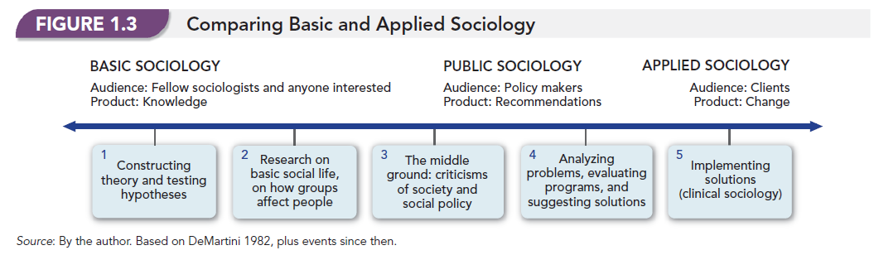

Slide 26
Applying Theory
Define, explain and support one of the main theoretical perspectives functional, conflict, or symbolic interaction?

